Slide 1
INTERNATIONAL RELATIONS
CONTENTS
DEFINITION
SCOPE
IMPORTANCE
ACTORS
GEOGRAPHY

Slide 2
CONTENTS
Historical Context of Contemporary International System
Major Theories Of International Relations
The International System
The State
Diplomacy
Collective Security
Disarmament
International Law

Slide 3
Globalizing Issues
Terrorism
Human Rights
The Environmental degradation
Population Issues and natural resource depletion
China-US bilateral relations
Kashmir issue
Palestine issue
Russia-Ukraine issue

Slide 4
Muslim genocide in India
INTENSIFYING CLIMATE CRISIS
MANAGING THE FALLOUT FROM COVID-19’S LONG TAIL
Saudi-Iran Rapprochement
Syria: Years of war trigger a health crisis
Ukraine: War creates world’s largest displacement crisis
Dangerous Predicament on the Korean Peninsula

Slide 5
Books
Andrew Heyood, Global Politics, Palgrave Macmillan foundation
Richard W. Mansbach And Kirsten L. Rafferty, Introduction to Global Politics, Routledge NeYork
Steve Smith, John Baylis and Patricia Owens, The Globalization of World Politics.
Joseph S. Nye, Jr., Understanding International Conflicts: An Introduction to Theory and History
Scott Burchill, Theories of International Relations. 3rd Edition.
Charles W. Kegley, Jr. World Politics: Trends and Transformation. Eleventh Edition.
Mingst, Karen. Essentials of International Relations. New York: W.W. Norton & Company, Inc, 2008.(Core Book)
Goldstein, Joshua. International Relation; Washington DC: Pearson Tenth Education, 2013-2014.

Slide 6
International Relations
The term ‘International’ was used for the first time by Jeremy Bentham (1748 –1832, The Principles of Morals and Legislation) in the later part of the 18th century.
International relations refers to the collective interactions of the international community, which includes individual nations and states, inter-governmental organizations such as the United Nations and other non-governmental organizations.
IR is not confined with one field such that only politics among nations it includes other social structures e.g. economic, culture, and domestic politics. Therefore, IR is a large subject that overlaps several other fields.

Slide 7
International relations (IR) is the study of relationships between countries, including the roles of States, Inter- governmental Organization (IGOs), International Non- governmental Organization (INGOs), Non-governmental Organization (NGOs) and Multinational Corporations (MNCs).

Slide 8
Scope
The scope of IR should include study of "varied types of groups-nations, states, governments, peoples, regions, alliances, confederations, international organizations, even industrial organizations, cultural organizations, religious organization" etc. which are involved in the conduct of these relations.
Professor Alfred Zimmern had written before the Second World War that : "International Relations . . . . . is clearly not a subject in the ordinary sense of the word. It does not provide a single coherent body of teaching material . . .. . It is not a single subject but a bundle of subjects . . . . . of law, economics, political science, geography, and so on . . . . . "

Slide 9
Study of state systems
Study of relations among states
Study of National Interests
Study of National Power
Study of International Law
Study of Foreign Policy
Study of International Organizations
Study of geopolitics
Study of Global Environmental Issues
Study of Conflict Management and Conflict Resolution

Slide 10
UTILITY OF THE STUDY OF IR
No country in the World can live in isolation.
We are today living in an interdependent state - system. It is essential for all of us to have a clear idea of what is happening in the world. Political events are important, but even economic developments, trade, commerce and activities of actors like multinational corporations are no less significant.

Slide 11
We live in an age of growing international cooperation. Therefore, not only do the activities of the United Nations and its numerous agencies affect all the nations and their peoples, but regional organizations like the European Union, South Asian Association of Regional Cooperation (SAARC), Association of South East Asian Nations (ASEAN) and the ' Organization of African Unity (OAU) also play important roles in our lives.
International terrorism has been a concern for the humankind and economic institutions like the World Bank and the World Trade Organization (WTO) affect international relations. The study of International Relations has therefore become highly useful and enlightening for students and others alike.

Slide 12
The 20 century witnessed two world war which was very dangerous in their destruction of man and material. It is feared that a third world war would wipe out the human race on earth if it comes.
The study of IR helps us to analyze and aims of the states in the world affairs, the methods adopted for that attainment of these objects and the factors which ultimately lead to their success or failure.
The international understanding helps us to analyze ways adopted by all the states to live boldly and confidently in the world of diversity with peacefully.

Slide 13
Today the modern weapons of warfare have became very sophisticated and too much danger in a matter of few hours they can wipe out millions of population by their atom bombs, germ warfare etc.
Environmental degradation and climate change is another perspective in recent years that is altogether changing the course of history.
It warns about the threat to the world peace and need to have precautionary measure. To educate the people in the interest of the very survival of human race.
The study of the IR aims at better understanding of problems of the world. Any states which violate international peace should be silenced by collective actions of all the states.

Slide 14
It avoids international conflicts and ensures international peace – It helps to understand the true importance of collective security and disagreement. These all are making way for the new concept of Global village or ―World Community.

Slide 15
NATURE OF IR Narrow-limited before WWII Broad and extended after WWII
The nature of a subject refers to the characteristics of that subject. In that sense, the natures of International relations are in the following:
Struggle for Power
As an Interdisciplinary Subject
National Interest and power are the core of IR
Continuous Interaction among Nation States
State is the primary actor in IR
Changing nature of International relations (Multilateralism, Nuclear age, Information revolution, Liberal economy)

Slide 16
Actors of International Relations
STATE
According to 1933 Montevideo Convention on the Rights and Duties of States, a state is composed of
a defined territory demarcated by specific boundaries
a defined population residing in that territory
an integrated set of institutions that is capable of making and enforcing laws over this population (internal sovereignty)
the recognition by other states of the sovereignty of that state (external sovereignty).

Slide 17
State-centrism:
An approach to political analysis that takes the state to be the key actor in the domestic realm and on the world stage. Since the 1970s, indeed, pluralist theorists have advocated a mixed-actor model of world politics. However, although it is widely accepted that states and national governments are merely one category of actor amongst many on the world stage, they may still remain the most important actors. No TNC or NGOs, for instance, can rival the state’s coercive power, either its capacity to enforce order within its borders or its ability to deal militarily with other states.

Slide 18
NON STATE ACTORS
Actors that
share some but not all of the characteristics of states (sub-state actors)
incorporate two or more states in a new entity (e.g. international organizations)
Non state Actors can be categorized on:
International Organizations
Multinational Corporations
Non-governmental Organizations

Slide 19
Institutions with formal membership and procedures, only states are members, membership can be limited or universal and purpose may be broad or narrow. Examples of IO’s
Limited Membership, Narrow Purpose:- Organization of Petroleum Exporting Countries
Limited Membership, Broad Purpose :-African Union
Universal Membership, Narrow Purpose:- Universal Postal Union
Universal Membership, Broad Purpose:- United Nations

Slide 20
MNCs are organizations that seek to make a profit by engaging in foreign production, marketing, finance, and staffing through directly controlled affiliates located in several states. Examples of MNCs
Coca-Cola, Sony, Nike, Mac Donalds
Broad category - Not states and non- profit. Includes religions, charities, political activists, academic research communities, and even terrorist groups. Examples of NGOs International Red Cross.

Slide 21
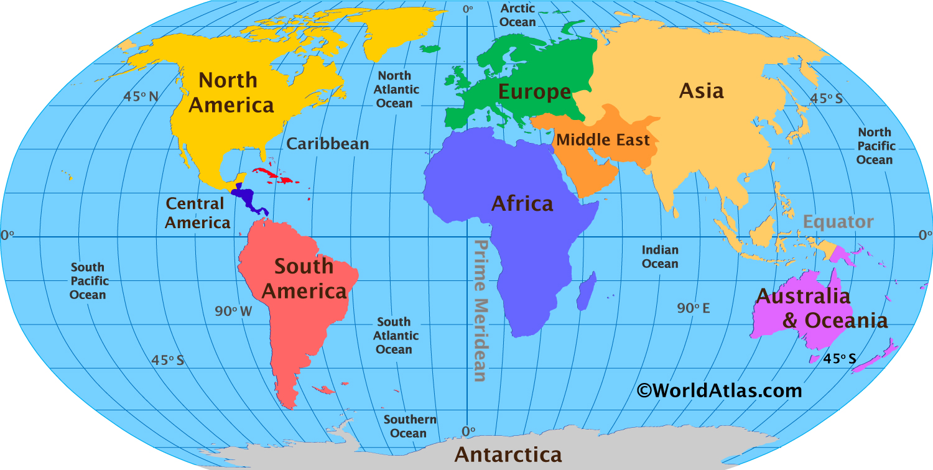

Slide 22
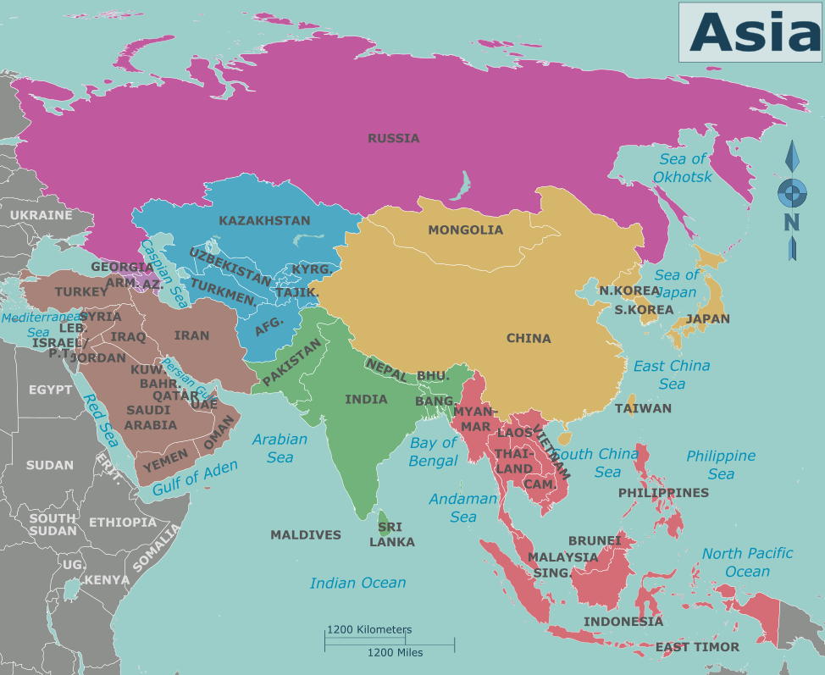
ASIA

Slide 23
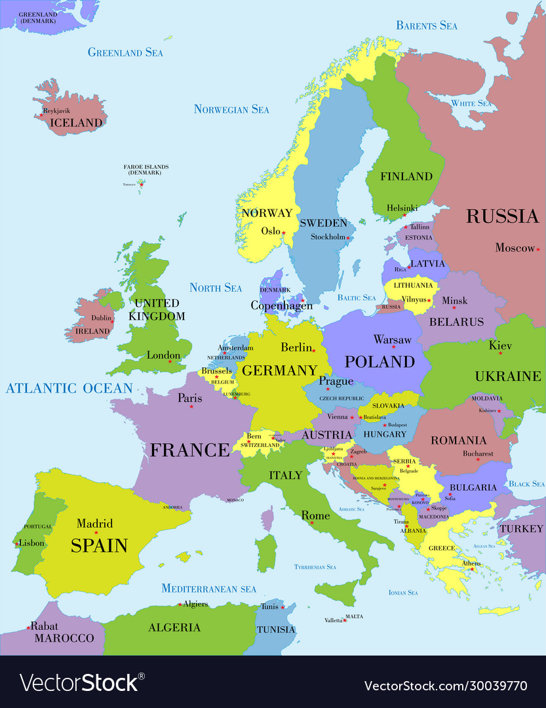
EUROPE

Slide 24
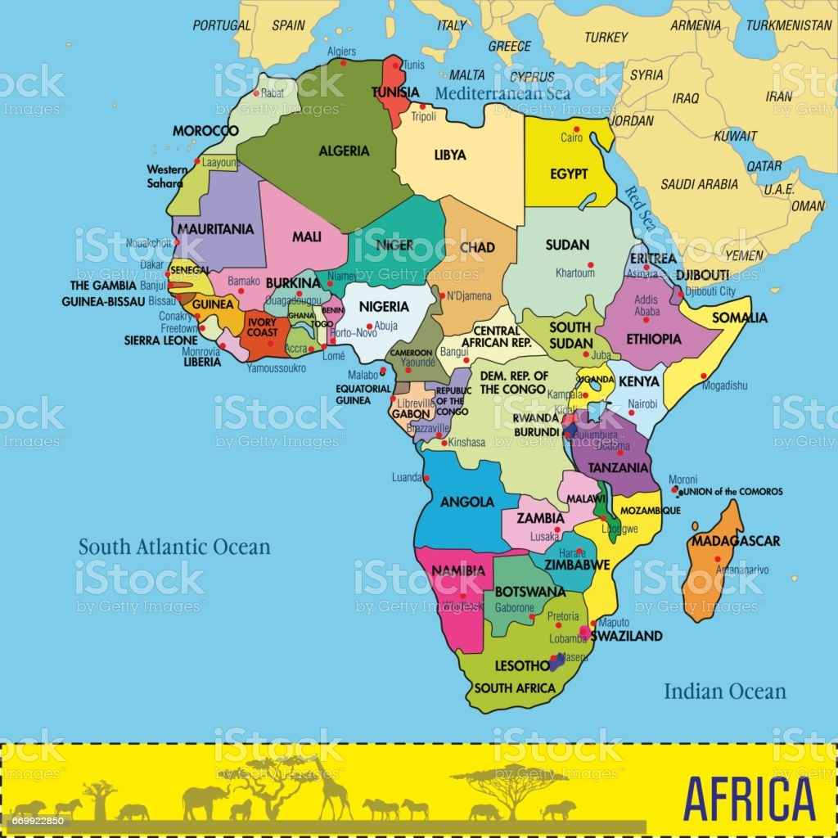
AFRICA

Slide 25
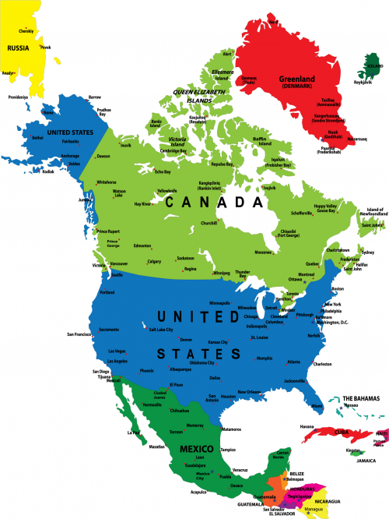
NORTH AMERICA

Slide 26
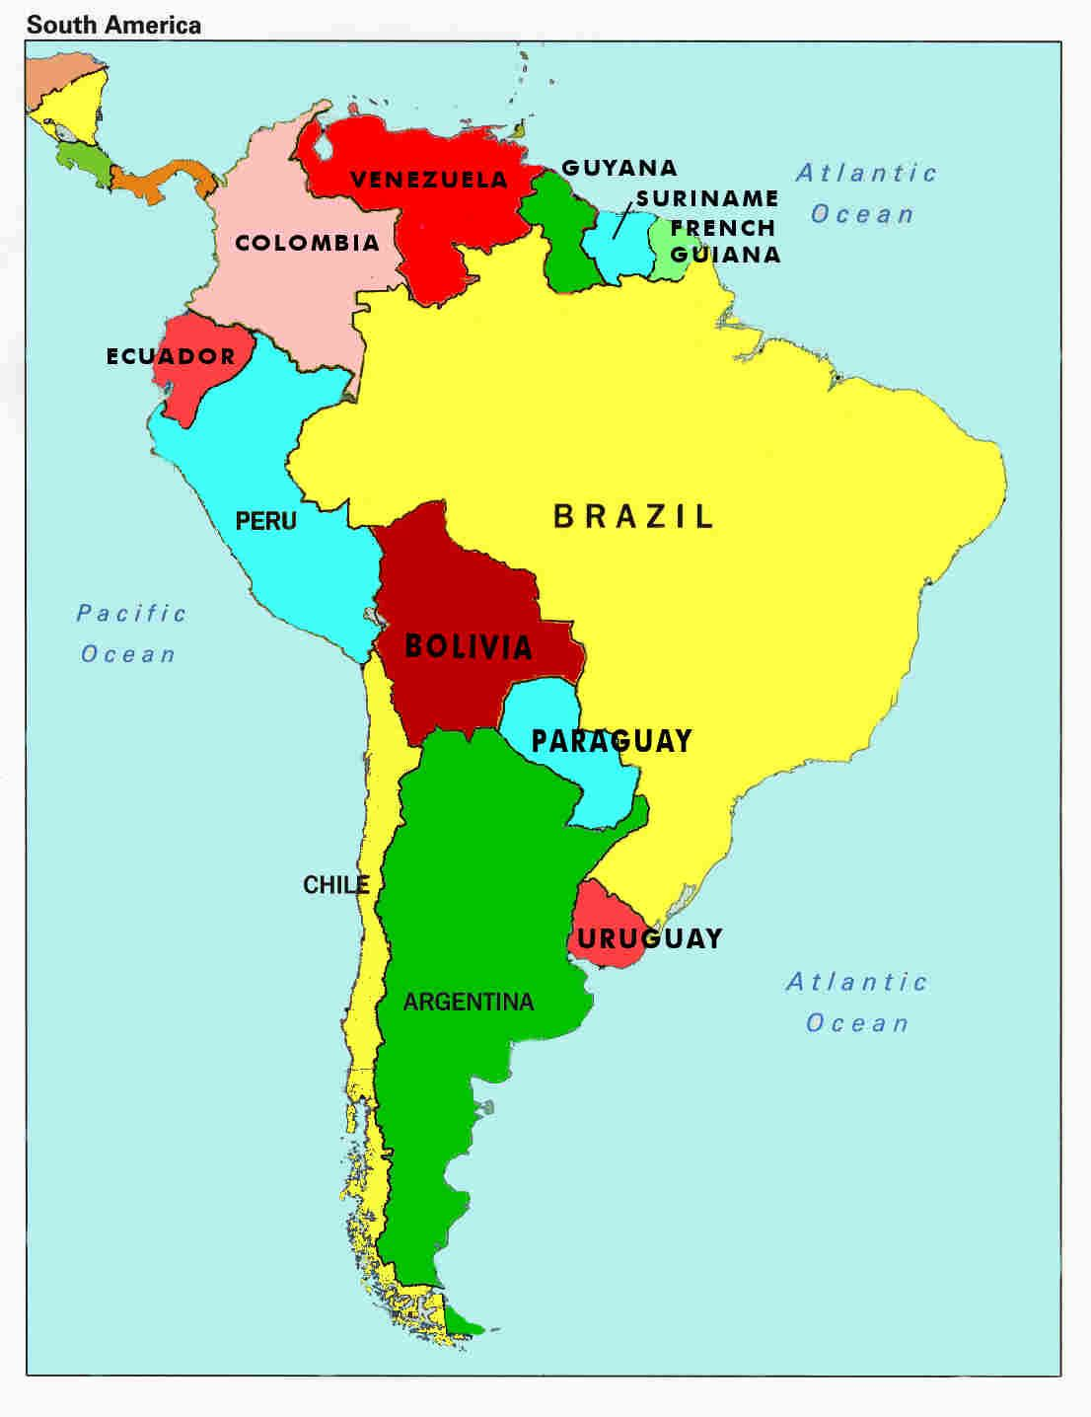
SOUTH AMERICA

Slide 27
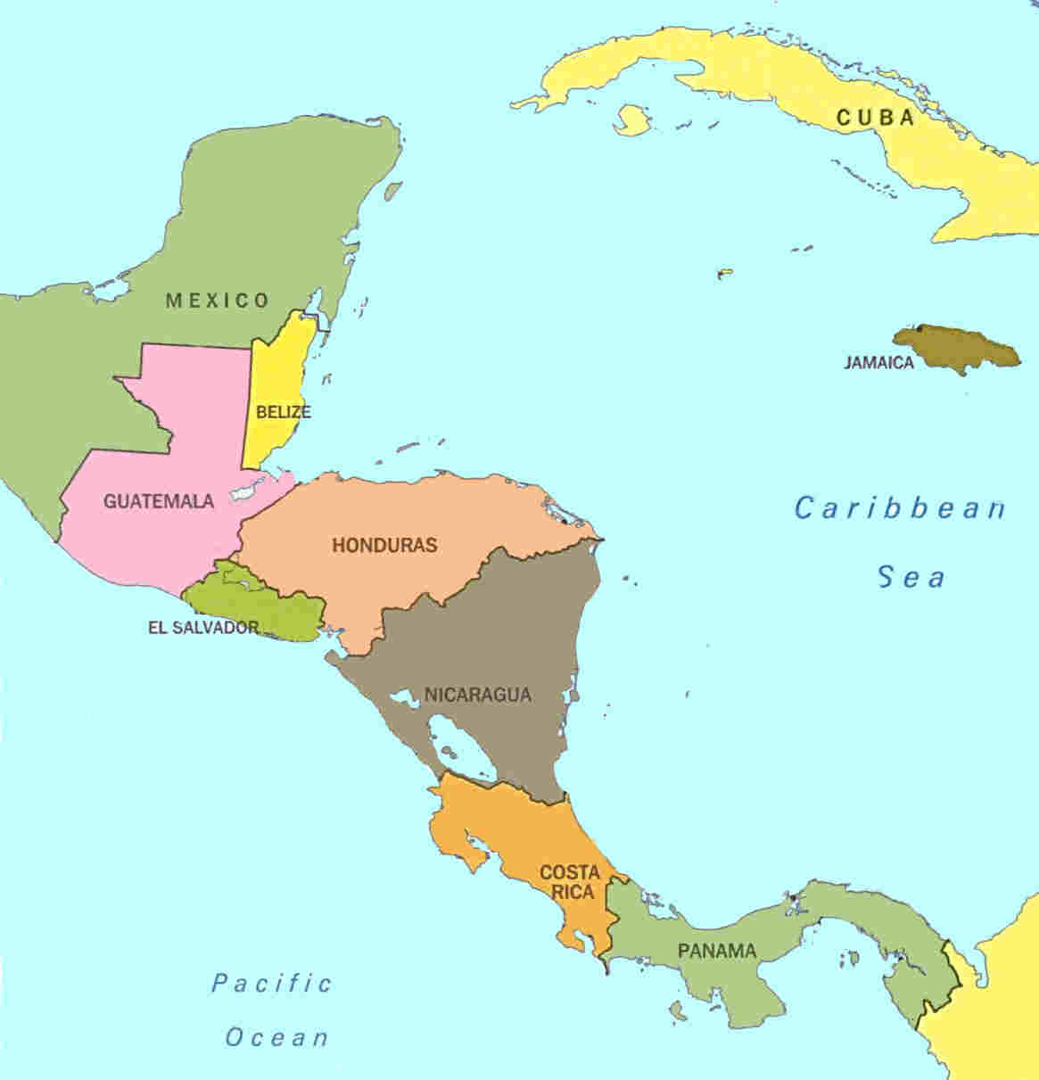
CENTRAL AMERICA

Slide 28
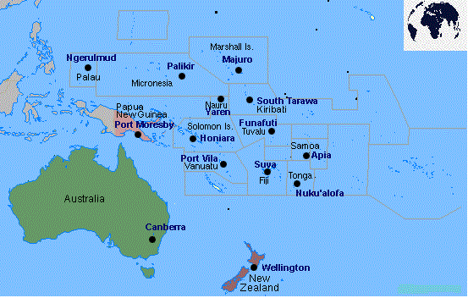
OCEANIA

Slide 29
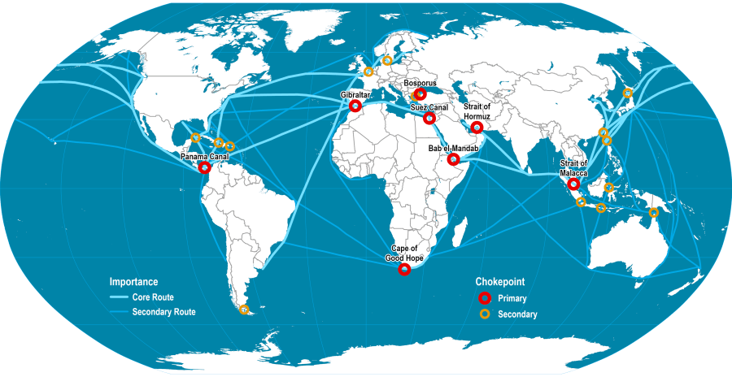
Major Straits Of The World

Slide 30
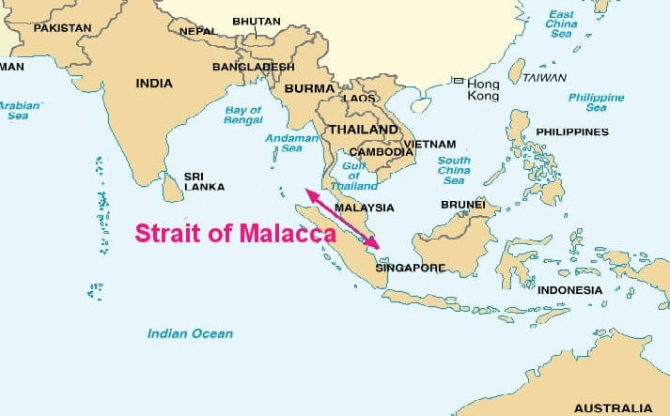
Malacca Strait: Andaman Sea & South China Sea Location: Indonesia –Malaysia

Slide 31
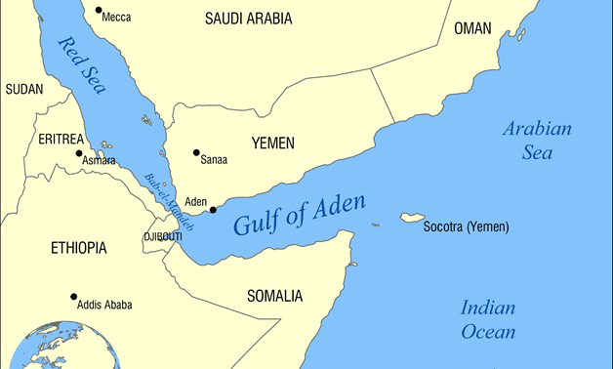
Bab-el-Mandeb Strait Join: Red Sea & Gulf of Aden Location: Yemen-Djibouti

Slide 32
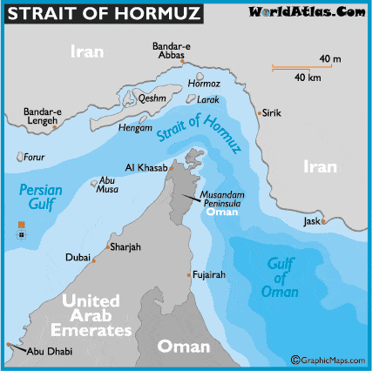
Hormuz Strait Join: Gulf of Persia & Gulf of Oman Location: Oman-Iran

Slide 33
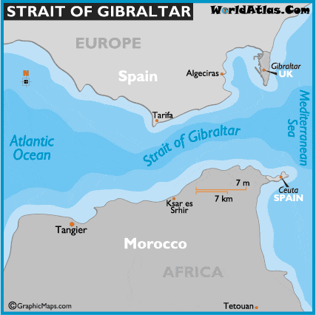
Gibraltar Strait Join: Mediterranean Sea & Atlantic Ocean Location: Spain-Morocco

Slide 34
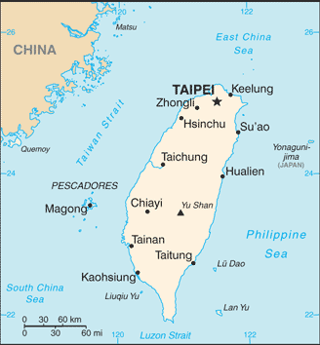
Taiwan Strait (Formosa Strait) Join: South China Sea & East China Sea Location: China-Taiwan

Slide 35
INTRODUCTION TO GLOBAL POLITICS (RICHARD W. MANSBACH-KIRSTEN L. RAFFERTY)
THREATS AND OPPORTUNITIES (PG : 1-11)
THE EVOLUTION OF THE INTERSTATE SYSTEM AND ALTERNATIVE POLITICAL SYSTEMS (PG : 55-79)
THE GLOBALIZATION OF WORLD POLITICS- AN INTRODUCTION TO INTERNATIONAL RELATIONS (JOHN BAYLIS STEVE SMITH PATRICIA OWENS)
LIST OF CASE STUDIES (PG: xxiii)
INTRODUCTION (PG : 1-09)

